Slide 1
Digital Business and E-Commerce Management
Lesson 3
Managing Digital Business Infrastructure

Slide 2
Managing Digital Business Infrastructure
At the end of the lesson, you will be able to:
Outline the range of hardware and software technologies used build a digital business infrastructure within an organization and with its partners.
1
Review the actions needed to maintain service quality for users of digital platforms.
2

Slide 3
Activity 3.1
Refer to your book for Activity 3.1

Slide 4
Digital Business Infrastructure
Defining an adequate technology infrastructure is vital to all start-up online businesses and existing companies making the transformation to digital business
The infrastructure and support of different types of digital platforms directly affect the quality of service experienced by users of the system in terms of speed and responsiveness.

Slide 5
Digital Business Infrastructure (Typical problems encountered by customers)
Web site communication too slow
Web site not available
Bugs on site through pages being unavailable or information typed in forms not being executed
Ordered products not delivered on time
Emails not replied to
Customer’s privacy or trust is broken through security problems such as credit card being stolen or address sold to other companies

Slide 6
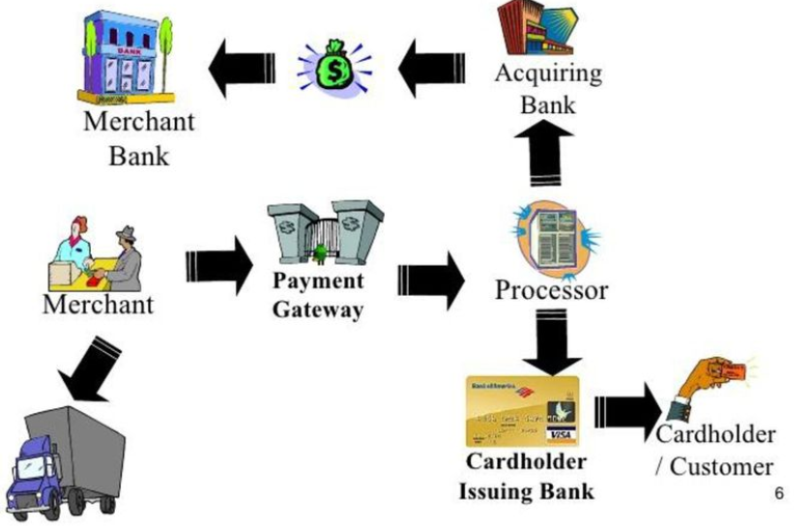
Digital Business Infrastructure (What does business need?)

Slide 7
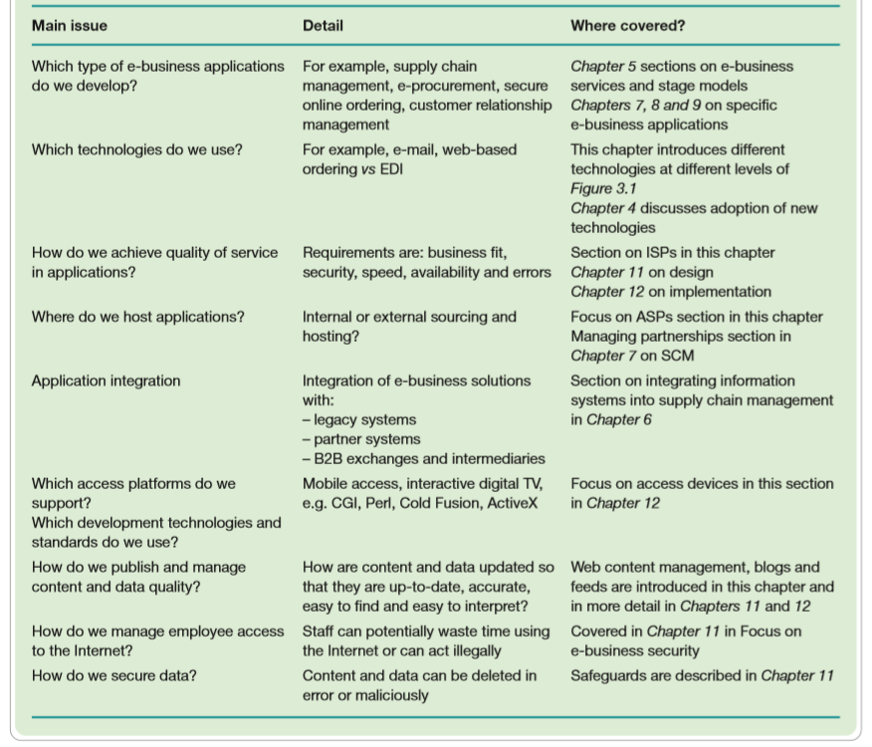
Key Management Issues of digital business infrastructure
Digital Business Infrastructure

Slide 8
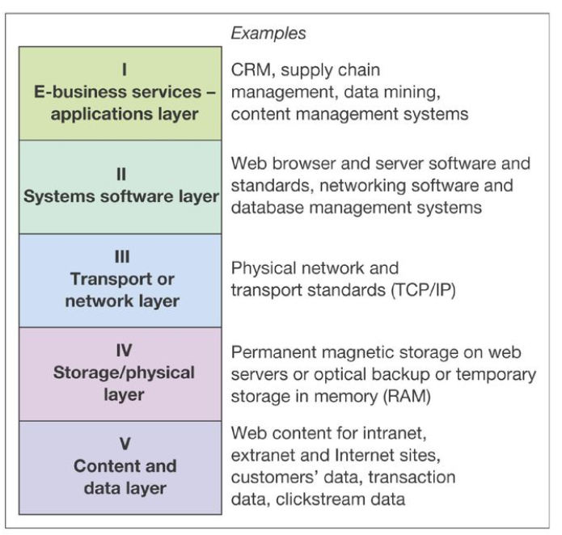
Digital Business Infrastructure Components
A five-layer model of digital business infrastructure

Slide 9
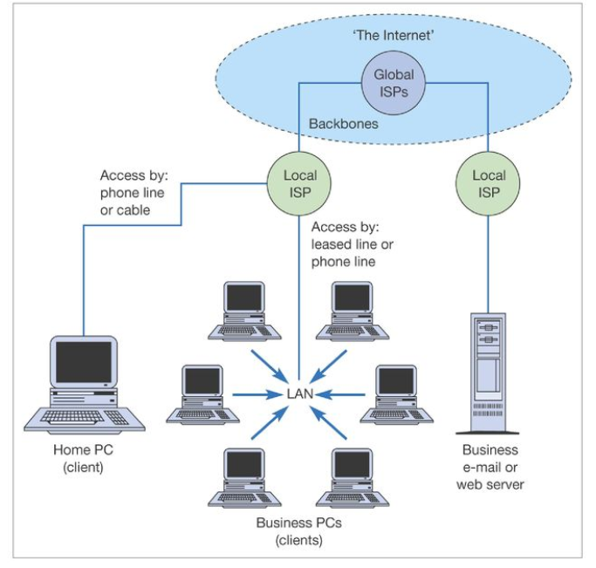
Digital Business Infrastructure Components
Physical and Network Infrastructure components of the Internet (Level IV and III)

Slide 10
Platforms which marketers can use to reach and interact with their audience through content marketing or advertising
Digital Business Infrastructure
Desktop browser- based platforms
Desktop apps or Mobile-based apps
Email platforms
Feed-based and API data exchange platforms
Video-marketing platforms
It could be argued that the major social networks, Facebook, LinkedIn and Twitter, also provide a form of platform, but these really exist across all of these technology platforms so it is not yet identified separately.

Slide 11
Digital Business Infrastructure
Mobile device use has already transformed the way consumers access online content and services for entertainment, socializing and purchase decisions
Many new opportunities to engage consumers through mobile marketing and location-based marketing.
With the growth in mobile platform usage by consumers it becomes important to assess whether companies are gaining similar levels of business from consumers using mobile platforms as from desktop platforms.

Slide 12
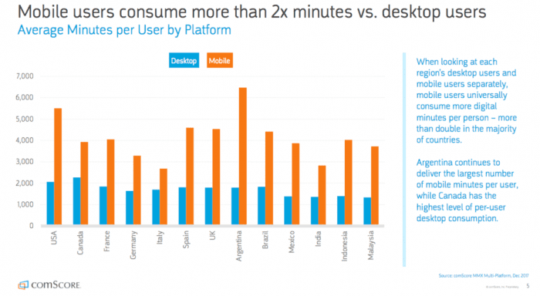
Digital Business Infrastructure (Mobile Usage Statistics)

Slide 13
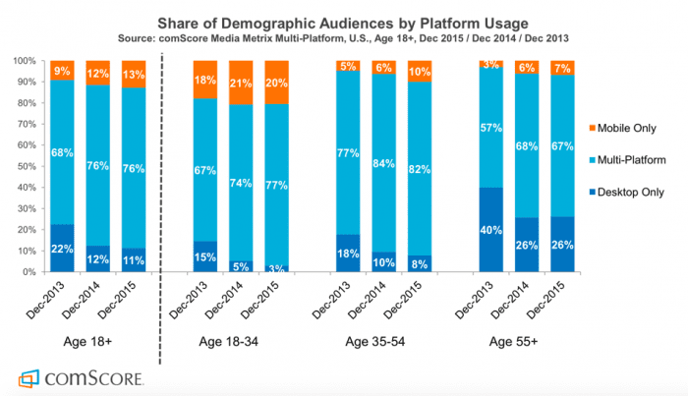
Digital Business Infrastructure (Mobile Usage Statistics)

Slide 14
Activity 3.2
Refer to your book for Activity 3.2

Slide 15
Digital Business Infrastructure (Challenges of creating a mobile web presence)
Challenge 1
One site or two? (Mobile App)
Issue
Should you transcode (“screen-scrape”) you main website into a standard mobile template to create a separate site, or optimize your site for mobile? Are mobile apps necessary?

Slide 16
Digital Business Infrastructure (Challenges of creating a mobile web presence)
Solution to Challenge 1
Create one site hosted on one URL fed by one CMS rather than building a separate website.
If there is a business case for mobile apps in terms of more revenue from apps compared to mobile sites then this need to be created

Slide 17
Digital Business Infrastructure (Challenges of creating a mobile web presence)
Challenge 2
Right Content
Issue
Agree on clearly defined content plan (news& info, entertainment, mobile commerce)

Slide 18
Digital Business Infrastructure (Challenges of creating a mobile web presence)
Challenge 3
UX
Issue
Smaller screen size and lack of keyboard
Make easy, simple navigation

Slide 19
Digital Business Infrastructure (Challenges of creating a mobile web presence)
Solution to Challenge 3
Use simple navigation
Use vertical instead of horizontal navigation

Slide 20
Digital Business Infrastructure (Challenges of creating a mobile web presence)
Challenge 4
Promotion
Issue
Mobile users want to find you quickly and easily on the mobile Internet

Slide 21
Digital Business Infrastructure (Challenges of creating a mobile web presence)
Solution to Challenge 4
Use all media channels to drive traffic
Use trackable link to detect which ones evaluate channel efficiently

Slide 22
Digital Business Infrastructure (Challenges of creating a mobile web presence)
Solution to Challenge 4
Use all media channels to drive traffic
Use trackable link to detect which ones evaluate channel efficiently

Slide 23
Digital Business Infrastructure (Taking the mobile vs. site decision)
Key Questions to ask
Are the apps a strategic priority?
Do we need to build our own app and/or leverage in an existing apps?
Free or paid apps?
Which category of applications to target?
How to best promote the app?
How to refine apps inline with feedback?

Slide 24
Activity 3.3
Refer to your book for Activity 3.3

Slide 25
Digital Business Infrastructure (Summary of Mobile or Wireless Internet access consumer proposition)
Elements of proposition | Evaluation
No fixed Location | The user is freed from the need to access via the desktop, making access possible when commuting
Location-based service | Mobiles can be used to give geographically based services, e.g. offer in a particular shopping centre.
Instant access/convenience | The latest GPRS and 4G services are always-on, avoiding the need for lengthy connection

Slide 26
Digital Business Infrastructure (Summary of Mobile or Wireless Internet access consumer proposition)
Elements of proposition | Evaluation
Privacy | Mobiles are more private than desktop access, making them more suitable for social use for a certain activity such as an alert service when looking for a new job and etc.
Personalization | As with PC access, personal information and services can be requested by the user, although these often need to be set up.

Slide 27
Management Issues in creating a new customer-facing digital service
Domain name selection
Selection of hosting service, including cloud providers
Selection of additional SaaS (Software as a Service)

Slide 28
Managing Digital business applications infrastructure
Management of the digital business applications infrastructure concerns delivering the right applications to all users of digital services.
01
The issue involved is one that has long been concern of IS Managers namely to deliver access to integrated applications and data that are available across the whole company.
02
Traditionally businesses developed application silos or islands of information
03

Slide 29
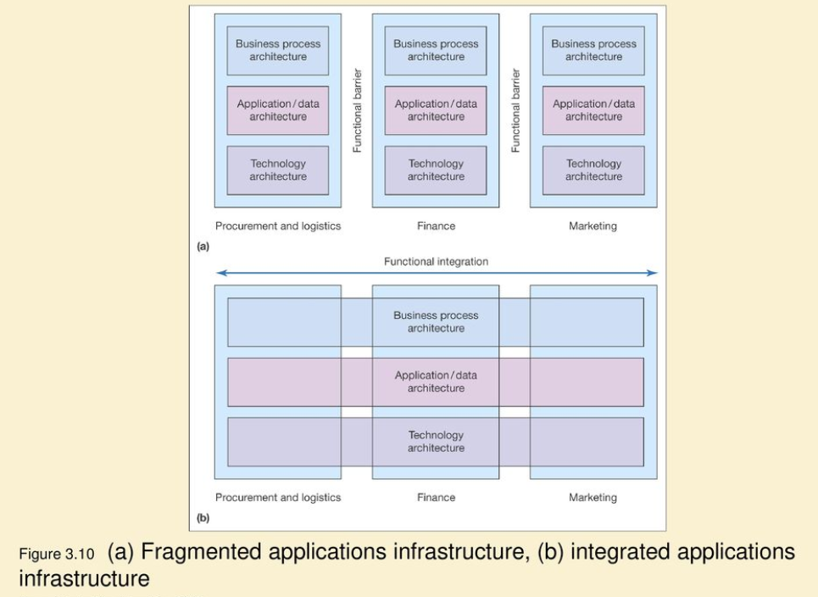

Slide 30
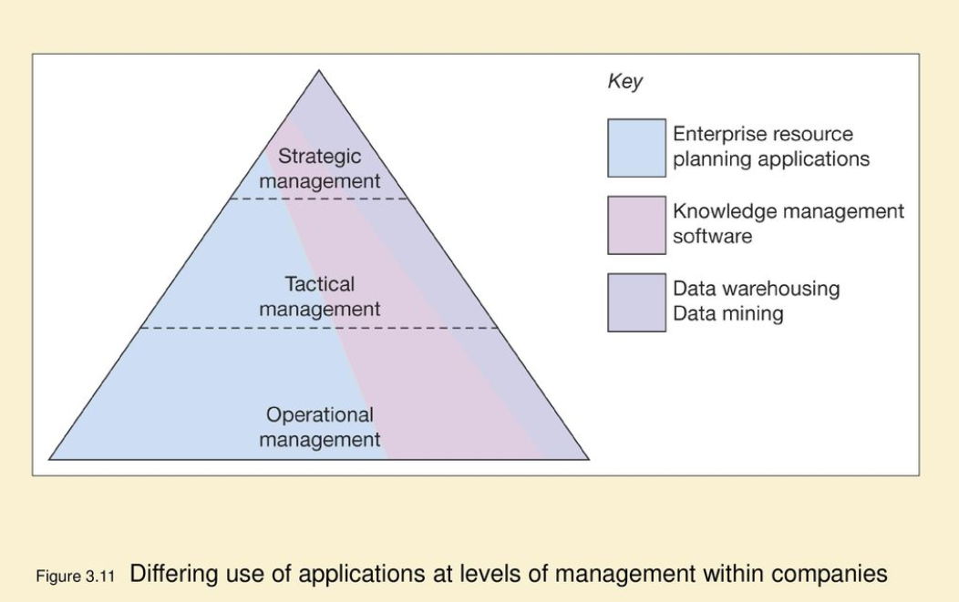

Slide 31
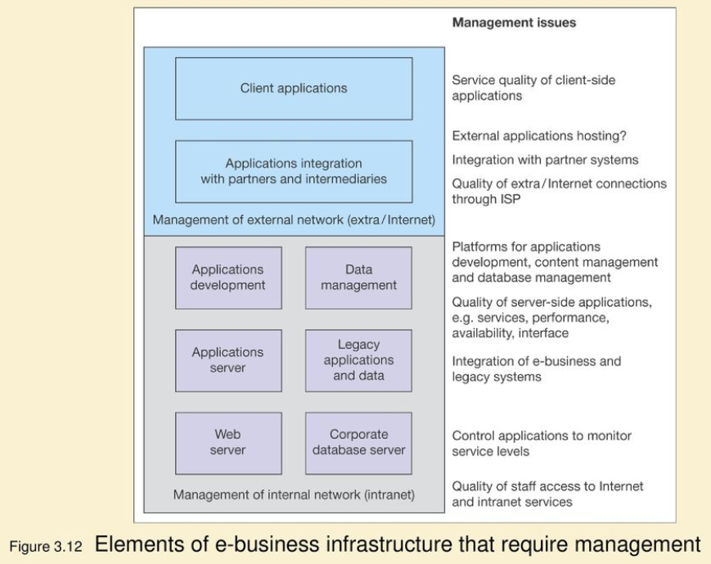

Slide 32
Managing Digital business applications infrastructure
Application silos or island of information are often a result of decentralization or poorly controlled investment in information system, with different departmental managers selecting different systems from different vendors.
This is inefficient in that it will often cost more purchase applications from separate vendors, and also it will be more costly to support and upgrade

Slide 33
Managing Digital business applications infrastructure
To avoid the problems of a fragmented application infrastructure, companies attempted to achieve the more integrated position.
Many companies turned to enterprise resource planning (ERP) vendors such as:
SAP
Baan
Poeplesoft
Oracle

Slide 34
Activity 3.4
Refer to your book for Activity 3.4

Slide 35
Managing Digital business applications infrastructure (Web Services or SaaS, cloud computing and service-oriented architecture (SOA))
The web service model involves managing and performing all types of business processes and activities through accessing web-based services rather than running a traditional executable applications on the processor of your local computer.

Slide 36
Managing Digital business applications infrastructure
Benefits of web service or SaaS
Usually paid according to usage
Installation and maintenance cost are effectively outsourced
Cost saving on both client side and server side

Slide 37
Managing Digital business applications infrastructure
Challenges of deploying SaaS
Downtime or poor availability of the network connection or server hosting the applications or server failure
01
Lower performance than a local database
02
Reduce data security since traditionally data would be backed up by in-house IT staff
03
Data protection – since customer data maybe stored in a different locations
04

Slide 38
Activity 3.5
Refer to your book for Activity 3.5

Slide 39
Managing Digital business applications infrastructure
Examples of cloud computing web services
Web Mail Readers
01
Services from google such as Google Maps, Gmail, Google Analytics & etc.
02
Customer Relationship Management Applications e.g. Salesforce
03
Supply Chain Management solutions from SAP and Oracle
04
Social Media Services such as Facebook, Twitter, Instagram & etc.
05

Slide 40
Managing Digital business applications infrastructure
Service-Oriented Architecture (SOA)
The technical architecture used to build web services
Arrangement of software processes or agents which communicate to each other to deliver the business requirements.

Slide 41
Managing Digital business applications infrastructure
Characteristics of SOA
An interface with the service which is platform-independent
01
The service can be dynamically located and invoked
02
The service is self-contained
03

Slide 42
Self-Assessment Questions
Refer to Activity booklet for questions which will help you review the topics covered in this lesson.

